Slide 1
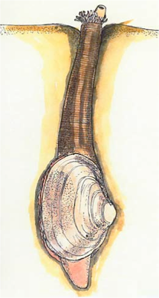
Welcome fellow clams!
You all grabbed a handful of beads…
  Each bead represents an allele from a gamete
How did your handful compare to those around you?
  Did you all grab the same amount and the same colors?
  What does your handful suggest about your genotype at that locus?
Why is this like clam reproduction?
Notes:
https://www.youtube.com/watch?v=s7Kzv0t-k9w

Slide 2
Gametes → Individuals
Will all gametes fuse in broadcast spawning?
If gametes fuse, will they always develop and become adults?
Can we predict the genotypes in the next generation from the gamete pool?
  Things we need to define first!
    What is an allele/gene/genotype?
    How many alleles does an individual have at a given locus?

Slide 3
Probabilities of gametes fusing
Our total alleles in the gamete pool are…
  Red (A) = _______ f_{A}= _______ Yellow (a) = _______ f_{a}= _______
What is the probability of two red (A) gametes fusing?
What is the probability of two yellow (a) gametes fusing?
What is the probability of a red (A) and yellow (a) gamete fusing, in any order?
Notes:
Note: AND rule / OR rule

Slide 4
Using Hardy-Weinberg to make predictions
We counted up our alleles as you were walking in…
  Known = allele frequencies in the gamete pool
What is Hardy-Weinberg Equilibrium?
  Null hypothesis → No Evolution!
If there is no evolution, then what are the assumptions of HWE?
  Large, randomly mating population,
  No selection,
  No genetic drift,
  No mutation, and
  No migration (gene flow).
If the assumptions are not met, then…
  Allele frequencies will change from one generation to the next (evolution), thus
  we may not be able to predict genotype frequencies using allele frequencies

Slide 5
Probabilities → Hardy-Weinberg
Hardy-Weinberg Equilibrium is simply probability
What is the HWE equation?
  p² + 2pq + q² = 1
  We have two alleles in our population. They are p and q. The frequency of them add to 1.
    p= f_{A}= _______ q = f_{a}= _______ (remember p+q=1)
Probability of two red (A) gametes fusing = p²
Probability of two yellow (a) gametes fusing = q²
Probability of a red (A) and yellow (a) gamete fusing (in any order) = 2pq

Slide 6
Frequency predictions → counts
We now have our predicted frequencies.
How do we figure out how many individuals in a population are expected of each genotype?
  Let’s say the population is 30 individuals…
Genotype | Frequency | Count expected
AA
Aa
aa
Genotype frequency x population size

Slide 7
Testing our predictions
Take a sample from the gamete pool
  Grab enough alleles for two individuals
    Make sure that you pull two alleles at a time
  Record the genotypes of your individuals
Our population:
  AA= Aa= aa=
  f_{AA}= f_{Aa}= f_{aa}=
What are the allele frequencies in our population?
  f_{A}=
  f_{a}=

Slide 8
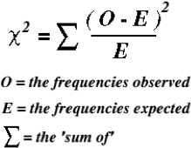
How can we tell if evolution happened?
Did we violate the H-W assumptions?
Need to do a Chi-square test.
degrees of freedom: df = k – 1 – m
k: number of classes
m: number of independent allele frequencies estimated

Slide 9
Chi-square test
What are our observed and expected values?
Genotype | Observed | Expected | O-E | (O-E)^2 | ((O-E)^2)/E
AA
Aa
aa
sum

Slide 10
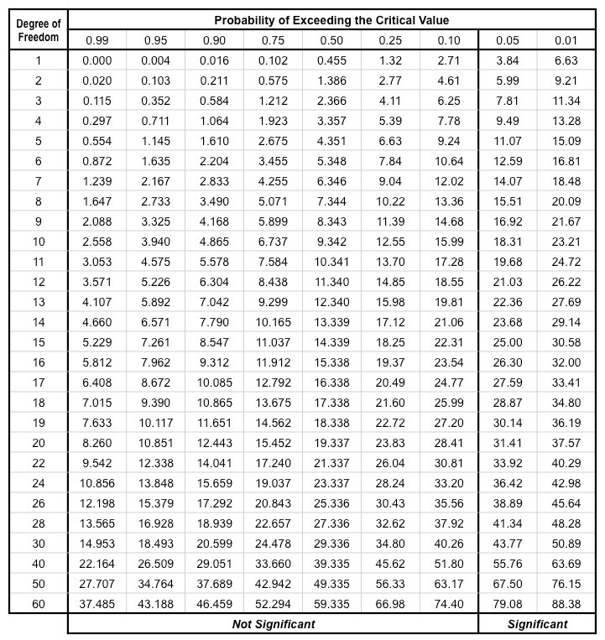
Chi-square test
Your chi-square test statistic:
d.f.= k-1-m = 3-1-1=1

Slide 11
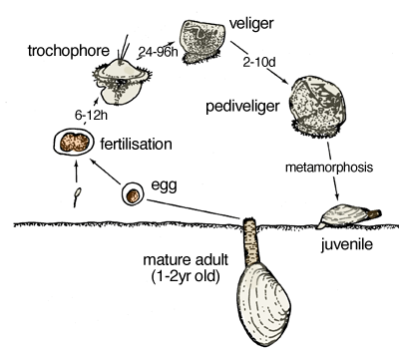
What would happen if we continued spawning...
Generation after generation?
If we don’t violate H-W assumptions…
then no evolution in our population.
Therefore, H-W is our null model!

Slide 12
Practice!
If you have a population of clams in which p=0.25, q=0.75….
  What is the probability that you get a heterozygous individual?
  What is the probability that you will get a homozygous individual?
If you have a population of clams in which AA=53, Aa=16, aa=5….
  What are genotype frequencies in the population?
  What are the allele frequencies?
  Do these observed values deviate from the expected values, given the allele frequencies?
    Do the chi-square test.

Slide 13
Welcome back fellow clams!
Last time we reviewed Hardy-Weinberg Equilibrium
Today we are investigating how deviations in HWE can change allele frequencies.
Instead of working as a whole class population, you are working in groups of 3 as unique population.

Slide 14
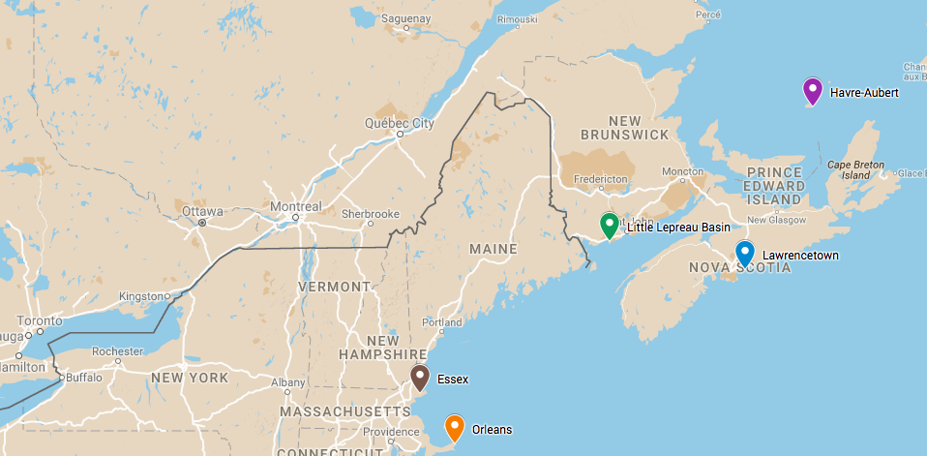
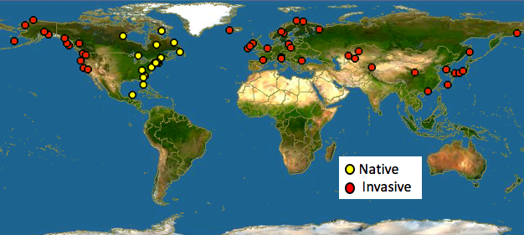
Populations of Mya arenaria (soft-shelled clams)
5 populations
Havre-Aubert, QC
Lawrencetown, NS
Lepreau Basin, NB
Essex, MA
Orleans, MA

Slide 15
Materials and Procedures
Each group should have a…
  bag of red and yellow marbles, 100 of each color
  population tray (ice cube tray) with 24 labelled wells
  Access the GoogleSheets link
    Blackboard site → Course Documents → Clams Activity link
Each group is a population of 24 individuals that die and replace themselves every generation
  On average each individual produces approximately 8 or more gametes → the gamete pool is limited to approximately 200 gametes each generation

Slide 16
Initial allele frequencies & making predictions
All populations have 100 red (A) and 100 yellow (a) beads
  Remember that each bead represents an allele in a gamete
What are the allele frequency of the gametes?
  f_{A} = p = ______ f_{a} = q = ______
  Fill this out on your worksheet and in your GoogleSheet in the “Generation 0” row
    Hint: Make sure that you are on the correct Population GoogleSheet
Predict the genotype counts in the next generation
  Determine genotype frequencies first (using allele frequencies)
    f_{AA} = p² = ______ f_{Aa} = 2pq = ______ f_{aa} = q² = ______
  Multiply the genotype frequencies by the population size to get predicted counts in a population of 24 individuals
    AA= p² x N = ______ Aa=2pq x N =______ aa= q² x N = ______
  Record your predictions on your worksheet.

Slide 17
Generation 1 - before event
Pull 24 individuals.
  Clams are diploid → pull two gametes at a time
  Place each individual (two gametes) into the numbered tray
Count all genotypes
  Record sum counts in your GoogleSheet
Calculate allele frequencies in your GoogleSheet
  We will use formulas!
But, are these the breeders for the next generation?
  Do they all survive to adulthood and produce offspring?

Slide 18
Generation 1 - after event
Draw one event card from your population deck.
  Read it → follow it → manually remove any necessary individuals from your tray
  Place the ‘used’ card off to the side
The population after the event is the population of contributing breeders into the next generation
  Calculate allele frequencies of the breeder population
    Are these allele frequencies different from the before event population?
  Readjust your gamete pool based on these allele frequencies
    Use short cut formulas to reduce counting time

Slide 19
Continue for about 6 generations (may be more)
Pull 24 individuals (2 alleles at a time from the gamete bag) and place individuals into each well of the population.
Record genotype counts and calculate allele frequencies in the “before event” row for that generation.
Draw one event card and follow the instructions.
Record genotype counts and calculate allele frequencies in the “after event” row for that generation.
The individuals remaining will contribute gametes into the next generation.
Calculate allele counts to be used to create a gamete pool of 200.
Empty the gamete bag of all gametes from the previous generation and make your new gamete pool.
Repeat until you reach Generation 11.

Slide 20
Final allele frequencies
Compare initial and final allele frequencies.
  Draw a figure depicting changes in allele frequencies over time.
  Determine if there is a significant difference between the first and final populations using a Chi-square test (see your notes from last time and your hints on your worksheet).
  Generate a conclusion about evolution in your population.

Slide 21
Comparing populations
Your group should have at least one person from each population.
Follow the worksheet to compare populations, trends, and environmental conditions.
Did all populations experience the same environmental conditions?
  How did the environmental conditions affect population genetics of the population?

Slide 22
Event cards for Activity 2

Slide 23
Havre- Aubert
It’s a beautiful day to spawn! Last one in the spawning pool is a rotten egg!
The last compartment doesn’t make it into the breeding population!!
Havre- Aubert
It’s a beautiful day to spawn! Last one in the spawning pool is a rotten egg!
Only the last compartment doesn’t make it into the breeding population!!
Havre- Aubert
It’s a beautiful day to spawn! In the spawning confusion some gametes did not find each other!
The middle compartment (number 12) doesn’t make it into the breeding population!!
Havre- Aubert
It’s a beautiful day to spawn! The early bird does not always get the worm!
The first compartment doesn’t make it into the breeding population!!
Havre- Aubert
It’s a beautiful day to spawn! In the spawning confusion some gametes did not find each other!
The middle compartment (number 12) doesn’t make it into the breeding population!!
Havre- Aubert
It’s a beautiful day to spawn! The early bird does not always get the worm!
The first compartment doesn’t make it into the breeding population!!
Notes:
No PSP exposure!

Slide 24
Havre- Aubert
DREDGING ACCIDENT: A fishing boat accidentally drags a dredge through your population. 15% of the clam population dies.
Remove individuals from every sixth compartment from the breeding population.
Havre- Aubert
INVASIVE COMPETITOR: A new species is introduced and it competes for your population’s resources. 20% of the clam population dies.
Remove individuals from every fifth compartment from the breeding population.
Havre- Aubert
STORM WARNING: A massive storm comes through bringing high tides, rough waves, and excessive sand. 25% of the clam population dies.
Remove individuals from every third compartment from the breeding population
Havre- Aubert
PREDATOR ATTACK: Sea stars have found your population! 10% of the clam population dies.
Remove individuals from every eighth compartment from the breeding population.
Notes:
No PSP exposure!

Slide 25
Lawrencetown
It’s a beautiful day to spawn! Last one in the spawning pool is a rotten egg!
The last compartment doesn’t make it into the breeding population!!
Lawrencetown
It’s a beautiful day to spawn! Last one in the spawning pool is a rotten egg!
Only the last compartment doesn’t make it into the breeding population!!
Lawrencetown
It’s a beautiful day to spawn! In the spawning confusion some gametes did not find each other!
The middle compartment (number 12) doesn’t make it into the breeding population!!
Lawrencetown
It’s a beautiful day to spawn! The early bird does not always get the worm!
The first compartment doesn’t make it into the breeding population!!
Lawrencetown
It’s a beautiful day to spawn! In the spawning confusion some gametes did not find each other!
The middle compartment (number 12) doesn’t make it into the breeding population!!
Lawrencetown
It’s a beautiful day to spawn! The early bird does not always get the worm!
The first compartment doesn’t make it into the breeding population!!
Notes:
No PSP exposure!

Slide 26
Lawrencetown
DREDGING ACCIDENT: A fishing boat accidentally drags a dredge through your population. 15% of the clam population dies.
Remove individuals from every sixth compartment from the breeding population.
Lawrencetown
INVASIVE COMPETITOR: A new species is introduced and it competes for your population’s resources. 20% of the clam population dies.
Remove individuals from every fifth compartment from the breeding population.
Lawrencetown
STORM WARNING: A massive storm comes through bringing high tides, rough waves, and excessive sand. 25% of the clam population dies.
Remove individuals from every third compartment from the breeding population
Lawrencetown
PREDATOR ATTACK: Sea stars have found your population! 10% of the clam population dies.
Remove individuals from every eighth compartment from the breeding population.
Notes:
No PSP exposure!

Slide 27
Lepreau Basin
It’s a beautiful day to spawn! Last one in the spawning pool is a rotten egg!
The last compartment doesn’t make it into the breeding population!!
Lepreau Basin
It’s a beautiful day to spawn! Last one in the spawning pool is a rotten egg!
Only the last compartment doesn’t make it into the breeding population!!
Lepreau Basin
It’s a beautiful day to spawn! In the spawning confusion some gametes did not find each other!
The middle compartment (number 12) doesn’t make it into the breeding population!!
Lepreau Basin
It’s a beautiful day to spawn! The early bird does not always get the worm!
The first compartment doesn’t make it into the breeding population!!
Lepreau Basin
It’s a beautiful day to spawn! In the spawning confusion some gametes did not find each other!
The middle compartment (number 12) doesn’t make it into the breeding population!!
Lepreau Basin
It’s a beautiful day to spawn! The early bird does not always get the worm!
The first compartment doesn’t make it into the breeding population!!
Notes:
PSP exposure!

Slide 28
Lepreau Basin
RED TIDE OUTBREAK: Local toxigenic dinoflagellate (Alexandrium spp.) populations bloom. Clams feed on these toxic plankton. Many of the clams that are susceptible to the toxin do not survive.
Remove the 50% of the homozygous recessive individuals.
Lepreau Basin
RED TIDE OUTBREAK: Local toxigenic dinoflagellate (Alexandrium spp.) populations bloom. Clams feed on these toxic plankton. Many of the clams that are susceptible to the toxin do not survive.
Remove 10% of the homozygous recessive individuals.
Lepreau Basin
RED TIDE OUTBREAK: Local toxigenic dinoflagellate (Alexandrium spp.) populations bloom. Clams feed on these toxic plankton. Many of the clams that are susceptible to the toxin do not survive.
Remove 75% of the homozygous recessive individuals.
Lepreau Basin
RED TIDE OUTBREAK: Local toxigenic dinoflagellate (Alexandrium spp.) populations bloom. Clams feed on these toxic plankton. Many of the clams that are susceptible to the toxin do not survive.
Remove 25% of the homozygous recessive individual.
Notes:
PSP exposure!

Slide 29
Essex
It’s a beautiful day to spawn! Last one in the spawning pool is a rotten egg!
The last compartment doesn’t make it into the breeding population!!
Essex
It’s a beautiful day to spawn! Last one in the spawning pool is a rotten egg!
Only the last compartment doesn’t make it into the breeding population!!
Essex
It’s a beautiful day to spawn! In the spawning confusion some gametes did not find each other!
The middle compartment (number 12) doesn’t make it into the breeding population!!
Essex
It’s a beautiful day to spawn! The early bird does not always get the worm!
The first compartment doesn’t make it into the breeding population!!
Essex
It’s a beautiful day to spawn! In the spawning confusion some gametes did not find each other!
The middle compartment (number 12) doesn’t make it into the breeding population!!
Essex
It’s a beautiful day to spawn! The early bird does not always get the worm!
The first compartment doesn’t make it into the breeding population!!
Notes:
PSP exposure!

Slide 30
Essex
RED TIDE OUTBREAK: Local toxigenic dinoflagellate (Alexandrium spp.) populations bloom. Clams feed on these toxic plankton. Many of the clams that are susceptible to the toxin do not survive.
Remove the 50% of the homozygous recessive individuals.
Essex
RED TIDE OUTBREAK: Local toxigenic dinoflagellate (Alexandrium spp.) populations bloom. Clams feed on these toxic plankton. Many of the clams that are susceptible to the toxin do not survive.
Remove 10% of the homozygous recessive individuals.
Essex
RED TIDE OUTBREAK: Local toxigenic dinoflagellate (Alexandrium spp.) populations bloom. Clams feed on these toxic plankton. Many of the clams that are susceptible to the toxin do not survive.
Remove 75% of the homozygous recessive individuals.
Essex
RED TIDE OUTBREAK: Local toxigenic dinoflagellate (Alexandrium spp.) populations bloom. Clams feed on these toxic plankton. Many of the clams that are susceptible to the toxin do not survive.
Remove 25% of the homozygous recessive individual.
Notes:
PSP exposure! -- may be make these a little less extreme than Lepreau Basin? Thoughts?

Slide 31
Orleans
It’s a beautiful day to spawn! Last one in the spawning pool is a rotten egg!
The last compartment doesn’t make it into the breeding population!!
Orleans
It’s a beautiful day to spawn! Last one in the spawning pool is a rotten egg!
Only the last compartment doesn’t make it into the breeding population!!
Orleans
It’s a beautiful day to spawn! In the spawning confusion some gametes did not find each other!
The middle compartment (number 12) doesn’t make it into the breeding population!!
Orleans
It’s a beautiful day to spawn! The early bird does not always get the worm!
The first compartment doesn’t make it into the breeding population!!
Orleans
It’s a beautiful day to spawn! In the spawning confusion some gametes did not find each other!
The middle compartment (number 12) doesn’t make it into the breeding population!!
Orleans
It’s a beautiful day to spawn! The early bird does not always get the worm!
The first compartment doesn’t make it into the breeding population!!
Notes:
PSP exposure!

Slide 32
Orleans
RED TIDE OUTBREAK: Local toxigenic dinoflagellate (Alexandrium spp.) populations bloom. Clams feed on these toxic plankton. Many of the clams that are susceptible to the toxin do not survive.
Remove the 50% of the homozygous recessive individuals.
Orleans
RED TIDE OUTBREAK: Local toxigenic dinoflagellate (Alexandrium spp.) populations bloom. Clams feed on these toxic plankton. Many of the clams that are susceptible to the toxin do not survive.
Remove 10% of the homozygous recessive individuals.
Orleans
RED TIDE OUTBREAK: Local toxigenic dinoflagellate (Alexandrium spp.) populations bloom. Clams feed on these toxic plankton. Many of the clams that are susceptible to the toxin do not survive.
Remove 75% of the homozygous recessive individuals.
Orleans
RED TIDE OUTBREAK: Local toxigenic dinoflagellate (Alexandrium spp.) populations bloom. Clams feed on these toxic plankton. Clams that are susceptible to the toxin do not survive.
Remove 25% of the homozygous recessive individual.
Notes:
PSP exposure!

